Slide 1

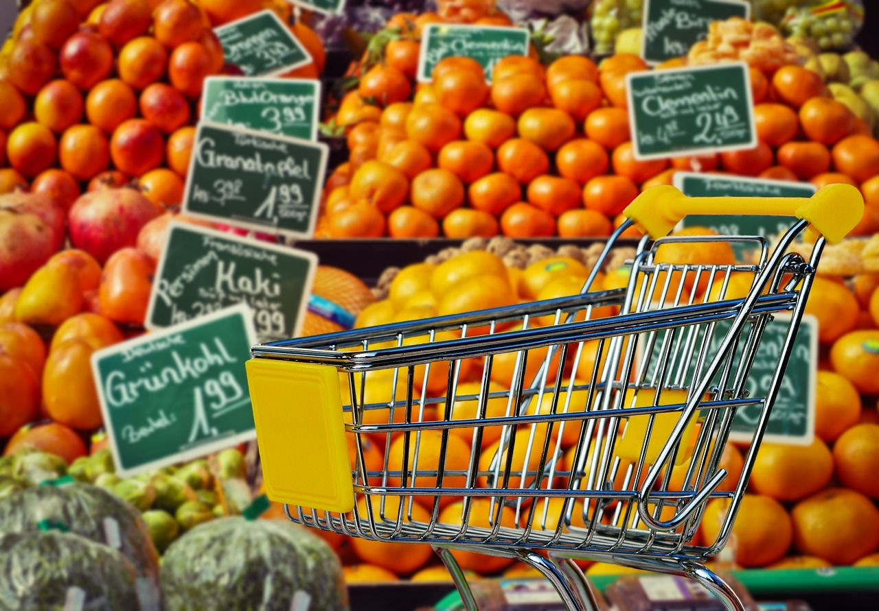
Supermarket Sales Analysis
By:
Omar Mohamed
Yehia fares
Yehia mohamed
Abdelfattah Aboud

Slide 2

Agenda
Project Description​
Objective
Goal
Step By Step Project Creation
Project Results
Sales Distribution
Sales
Number Of Orders
Number of Customer
Customer Satisfaction
Recommendation

Slide 3

Project Description​
This project involves a comprehensive analysis of three branches of a supermarket (Yangon, Naypyitaw, Mandalay) to identify essential factors that contribute to a supermarket success by examining three months of data from the supermarket.

Slide 4

Objective
Cleaning the dataset by handling missing values, correcting outliers, and removing duplicates.
Analyzing the relationship between different attributes such as total sales, branches, and customer types.
Visualizing key insights such as rush hours, sales distribution, and total sales per branch.

Slide 5

Goal
The goal of the project is uncovering patterns and insights that can guide the owner in his creative and business decisions.

Slide 6
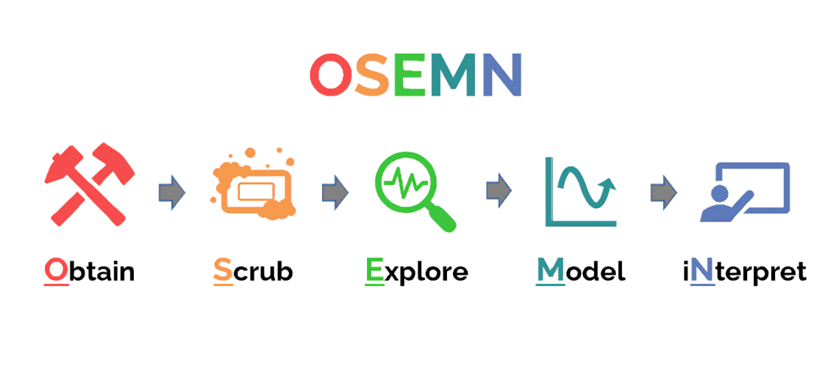
Step by step project creation

Slide 7
Step by step project creation
Obtain the data from Supermarket.
scrubing the data by (Python).
Tidiness Issues:
- Combined separate city columns into one City column for easier analysis Explore the data.
Missing Values:
- Filled missing data such as in the Customer Type column and corrected incorrect entries like "memberr“ and Recalculate not completed calculated columns.
Outliers:
- Corrected outliers in the Rating column (e.g., 97 instead of 9.7).
Duplicate Records:
- Removed six duplicate records from the dataset.

Slide 8
Step by step project creation
Explore the data and Find the Insights by (Python).
Create histograms to visualize distributions.
Produce scatter plots to assess the relationship between variables.
Modeling
iNterpret
Visualize the results in a dashboard to entire point of the process insights to the organization or stakeholders.

Slide 9

Project Results
Sales Distribution
Sales
Number Of Orders
Number of Customer
Customer Satisfaction

Slide 10
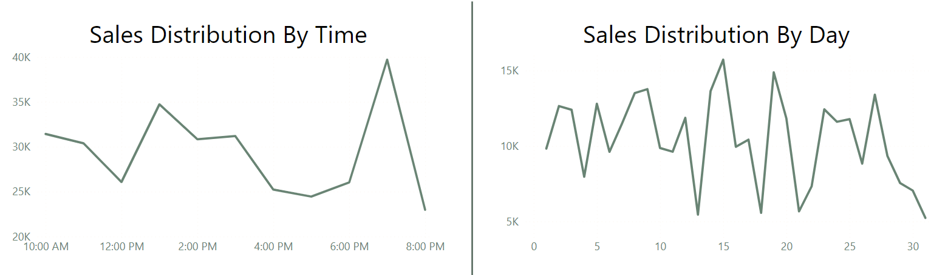
Sales Distribution

Slide 11
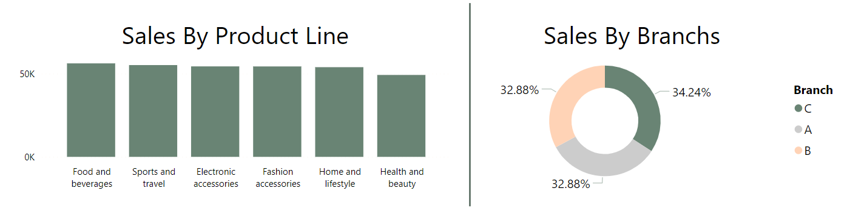
Sales

Slide 12
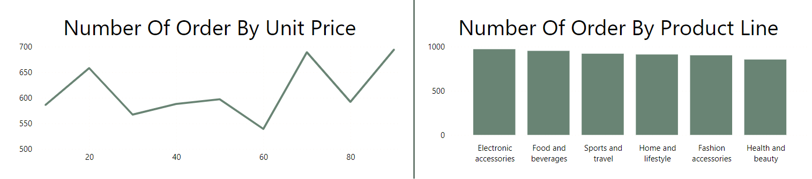
Number Of Orders

Slide 13
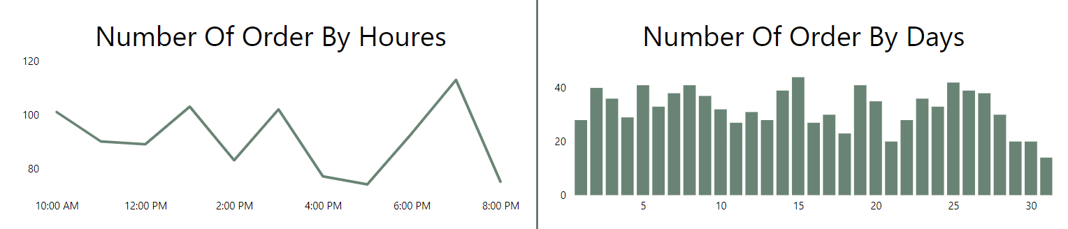
Number of Customer

Slide 14
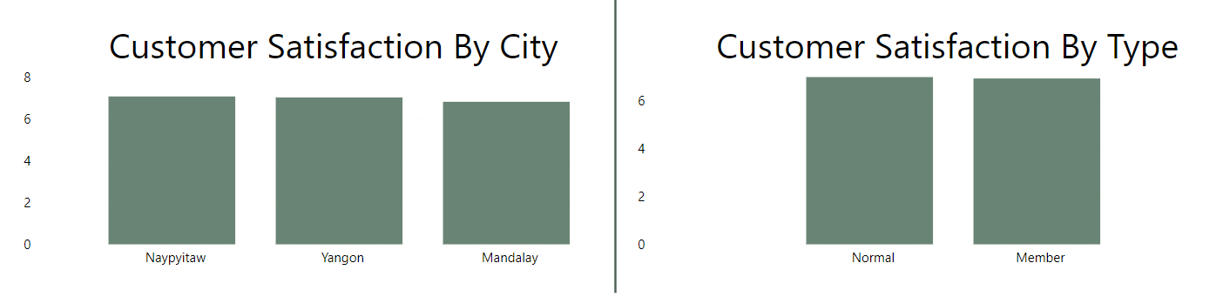
Customer Satisfaction

Slide 15
Recommendation
Recommendation depends on the data to achieve more Sales and Customer Satisfaction
Improve data storage quality and add more details about the customer and products
Extending the supermarket's operating hours after 8 o'clock
Increase customer satisfaction and differentiate between Normal and Member customers

Slide 16

Thanks

